Slide 1

Datasheet
Key points of Datasheets

Slide 2
Datasheet & it’s importance
A datasheet is a document that provides detailed information about a specific electronic component, product, or system. It typically includes technical specifications, performance characteristics, electrical properties, and other relevant details. Datasheets are widely used in the electronics industry and serve several important purposes:
IMPORTANCE:
Technical Details:
Datasheets provide in-depth technical information, helping users make informed decisions about component selection and usage.
Quality Assurance:
Manufacturers rely on datasheets to communicate the specifications and quality standards of their products to customers.
Regulatory Compliance:
Datasheets may contain information related to regulatory compliance and environmental considerations.
Product Lifecycle Management:
Datasheets assist in managing the lifecycle of products by providing documentation that aids in maintenance, repair, and upgrades.

Slide 3
CP2102 DATASHEET OVERVIEW
The CP2102 is a USB-to-UART bridge controller with a compact design for seamless integration into various applications. Key points from the datasheet:
Introduction:
USB-to-UART bridge controller.
Compliant with USB 2.0 full-speed standards.
Compact 5 x 5 mm QFN-28 package.
Functional Overview:
Operates as a virtual COM port.
Internal EEPROM (1024 bytes) for customization.
Pin Configuration:
Essential pins: VDD, GND, D+, D-, TXD, RXD, CTS, RTS, DSR, DTR, DCD, RI.
Electrical Characteristics:
Operating conditions: supply voltage range, current consumption, USB compliance.
Features and Capabilities:
USB suspend and resume support. 5 to 3 V voltage regulator.
Wide range of baud rates for UART communication. Device drivers for various operating systems.
Application Notes:
AN144, AN169, AN197, AN205, AN220 provide additional insights for customization and programming.

Slide 4
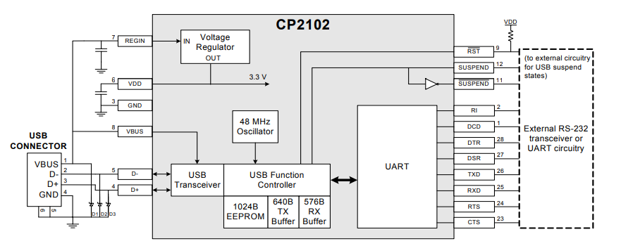
CP2102 FEATURES
Feature/Parameter | Description
USB Function Controller | USB 2.0 compliant, full-speed (12 Mbps)
UART Interface | Data formats: 5, 6, 7, and 8 bits
 | Stop bits: 1, 1.5, and 2
 | Parity: odd, even, mark, space, no parity
 | Baud rates: 300 bps to 1 Mbits
EEPROM | 1024-Byte, customizable for Vendor ID, Product ID, etc.
Voltage Regulator | On-chip, 3.3 V output
USB Compatibility | Windows Vista/XP/Server 2003/2000/98SE, Mac OS-X/OS-9, Linux
Driver Support | Virtual COM Port (VCP) and USBXpress
Power Options | Self-powered (3.0 to 3.6 V) or USB bus-powered (4.0 to 5.25 V)
Package | Lead-free 28-pin QFN (5 x 5 mm)
Ordering Part Number | CP2102-GM
Temperature Range | –40 to +85 °C

Slide 5
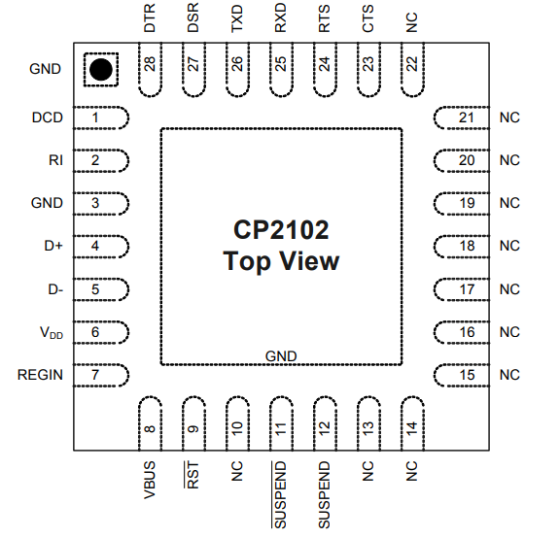
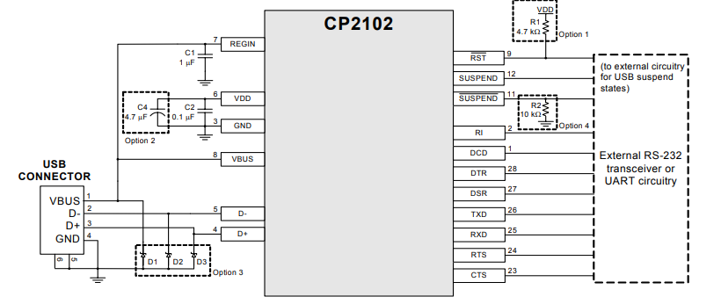
TOP VIEW & CIRCUITRY

Slide 6
CP2012 PINOUT
Pin Name | Type | Description
VDD (Pin 6) | Power In | 3.0–3.6 V Power Supply Voltage Input.
GND (Pin 3) | Ground | Ground.
RST (Pin 9) | D I/O | Device Reset. Open-drain output of internal POR or VDD monitor.
REGIN (Pin 7) | Power In | 5 V Regulator Input. This pin is the input to the on-chip voltage regulator.
VBUS (Pin 8) | D In | VBUS Sense Input. Connected to the VBUS signal of a USB network. A 5 V signal indicates a USB network connection.
D+ (Pin 4) | D I/O | USB D+ Line.
D- (Pin 5) | D I/O | USB D- Line.
TXD (Pin 26) | D Out | Asynchronous data output (UART Transmit).
RXD (Pin 25) | D In | Asynchronous data input (UART Receive).
CTS (Pin 23) | D In | Clear To Send control input (active low).
RTS (Pin 24) | D Out | Ready to Send control output (active low).
DSR (Pin 27) | D In | Data Set Ready control input (active low).
DTR (Pin 28) | D Out | Data Terminal Ready control output (active low).
DCD (Pin 1) | D In | Data Carrier Detect control input (active low).
RI (Pin 2) | D In | Ring Indicator control input (active low).
SUSPEND (Pin 12) | D Out | Driven high when the CP2102 enters the USB suspend state.
SUSPEND (Pin 11) | D Out | Driven low when the CP2102 enters the USB suspend state.
NC (Pins 10, 13-22) | - | Not connected. These pins should be left unconnected or tied to VDD.

Slide 7
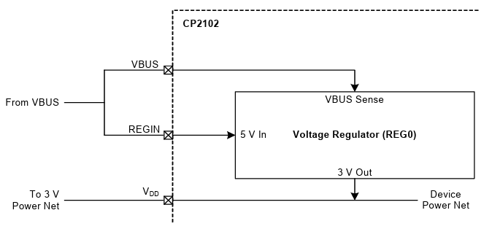
Additional Key Details:
SYSTEM OVERVIEW:
USB 2.0 compliant, full-speed (12 Mbps).
Compact 5 x 5 mm QFN-28 package.
No external components required for USB operation.
ABSOLUTE MAXIMUM RATINGS:
Ambient temperature under bias: –55 to 125 °C.
Storage Temperature: –65 to 150 °C.
Maximum Total current through VDD and GND: 500 mA.
GLOBAL DC ELECTRICAL CHARACTERISTICS:
Supply Voltage: 3.0 to 3.6 V.
Supply Current: 20 to 26 mA (Normal Operation, VREG Enabled).
USB Function Controller and Transceiver:
USB 2.0 compliant, full-speed.
USB suspend and resume states supported.

Slide 8
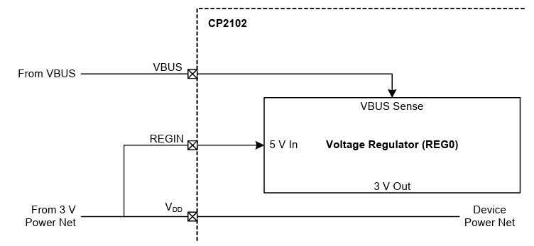
Additional Key Details:
USB Function Controller and Transceiver:
USB 2.0 compliant, full-speed.
USB suspend and resume states supported.
Asynchronous Serial Data Bus (UART) Interface:
Supports various data formats, stop bits, and parity options.
Baud rates from 300 bps to 1 Mbits.
Internal EEPROM:
1024-Byte EEPROM for customization.
Programmable via USB.
CP2102 Device Drivers:
Virtual COM Port Drivers for Windows, Mac, Linux.
USBXpress Direct Access Drivers.
Voltage Regulator:
On-chip 5 to 3 V voltage regulator.
Configurable as USB bus-powered or self-powered.

Slide 9
Thank You 1

